Slide 1

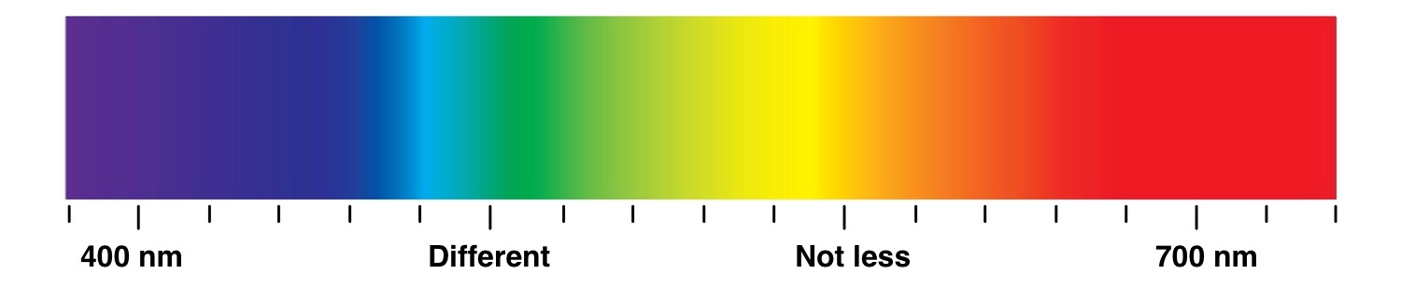

Slide 2
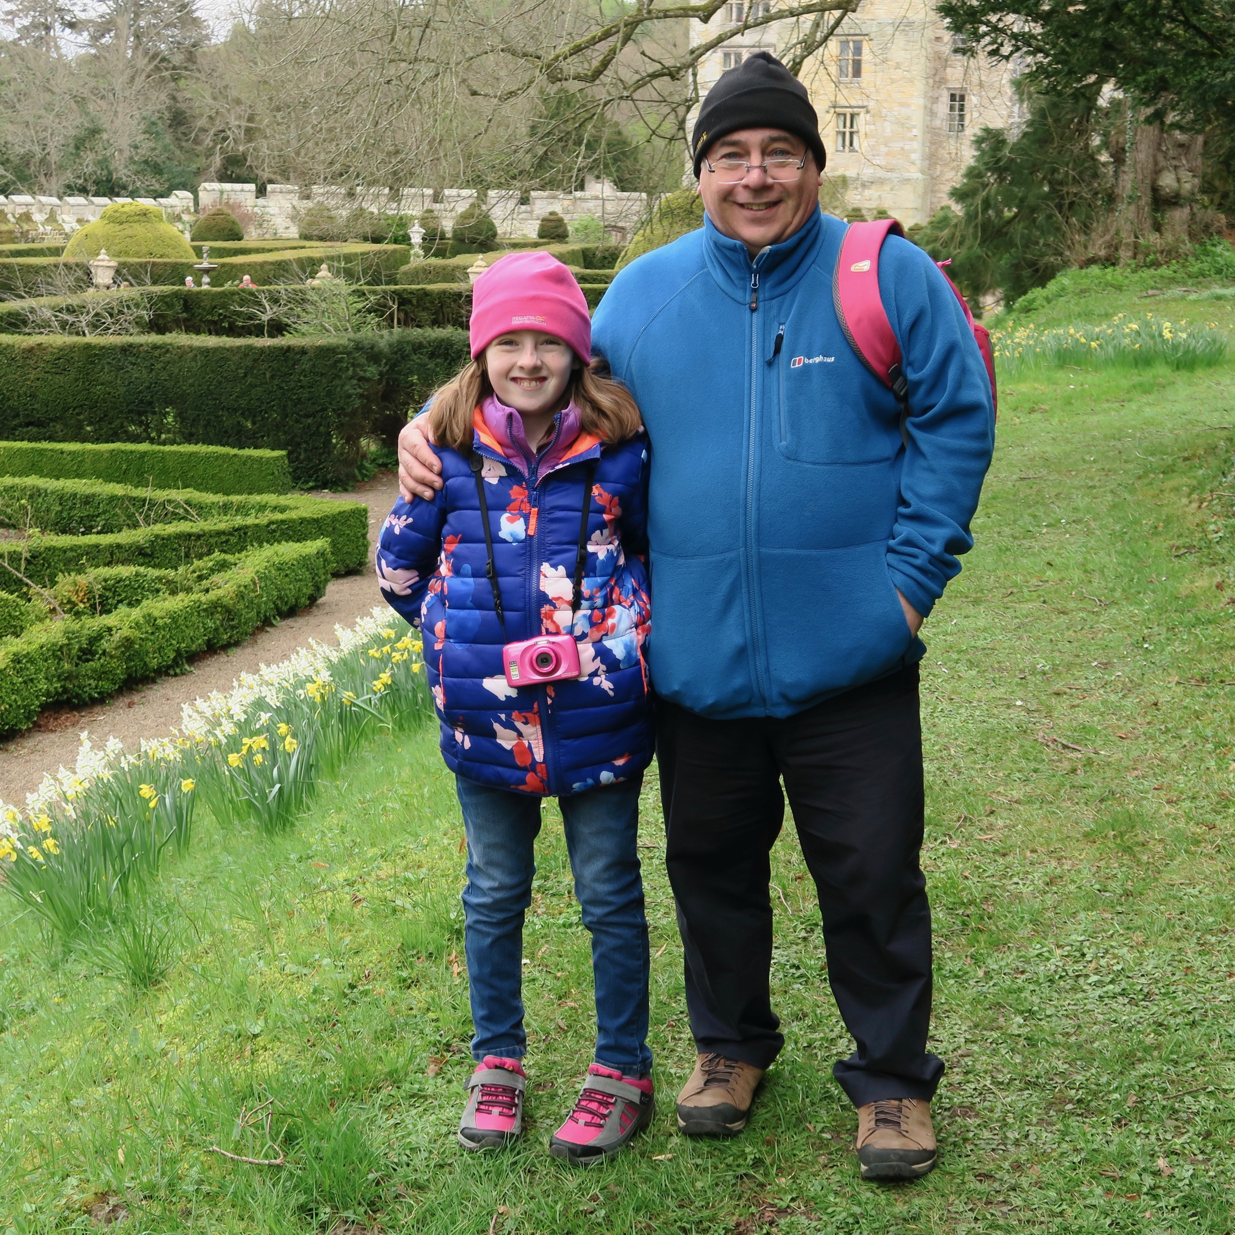
@autismclicks
Dad, Husband, Engineer
Andrew Rutter

Slide 3



Is there a link between
autism and engineering?
by Andrew Rutter

Slide 4

Temple Grandin
Movie

Slide 5


Slide 6


Slide 7

What is autism?
Understanding diversity
The link
What I learnt

Slide 8

What is autism?
Understanding diversity
The link
What I learnt

Slide 9

My background
In December 2011 my wife Sandra collected our daughter Emily from nursery.
Emily at the time had just turned 4
Sandra was handed this note... Which started a whole new chapter in our lives
Concerns Regarding the above child...
• Plays alone
• Will sit and watch other children
• Often can be found sitting ‘alone in her own world’ laughing to herself
7 months later we are walking out of a clinic with Emily and a diagnosis confirming she is autistic
That began a journey to find out as much as possible on the subject and how we can best support our daughter. On the way we have found many new friends who are also on their own journey with the condition
It can be deeply upsetting, frustrating and lonely, but also fascinating and opens up a new world of perspective
A different way of thinking…

Slide 10



What is autism?
Autism is a lifelong, developmental condition that affects how a person communicates
How they relate to other people
How they experience the world around them

Slide 11



What is autism?
Autism is a wide spectrum condition, whilst people all share certain difficulties, autism will affect people in different ways
Some people will be able to have successful careers whilst others will require a lifetime of specialist support
Autism is much more common than most people realise. It affects around 1 in 100 people, 700,000 in the UK. Together with their families, 2.8 million people are connected to autism

Slide 12




What is autism?
There is no scan or blood test to diagnose, tests rely on behaviour based assessments (ADOS). The boy to girl ratio is 4:1
Diagnostic and Statistical Manual of Mental Disorders (DSM-5) US, International Classification of Diseases (ICD-10) Eu
If you are autistic, you are autistic for life. There is no cure, but it may be managed with the right strategies
There are several sub-groups: AS, PDA, PDD-NOS
which are bundled under Autism Spectrum Disorder (ASD)
Asperger Syndrome, Pathological Demand Avoidance, Pervasive Development Disorder – not otherwise specified.
Sensory overload and difficulties in understanding can result in functioning meltdowns – not tantrums

Slide 13



After diagnosis
From medical diagnosis, support is typically passed to school (or even charity). With no cure or treatment, there is little support from your GP, hospital or clinic
With the school engaged and an EHC Plan in place, a plan can be agreed to provide the right level of support. This will fund the additional provision to support your child
Just because an Apple Mac is not running Windows does not mean it is broken

Slide 14
What is autism
Understanding diversity
The link
What I learnt

Slide 15
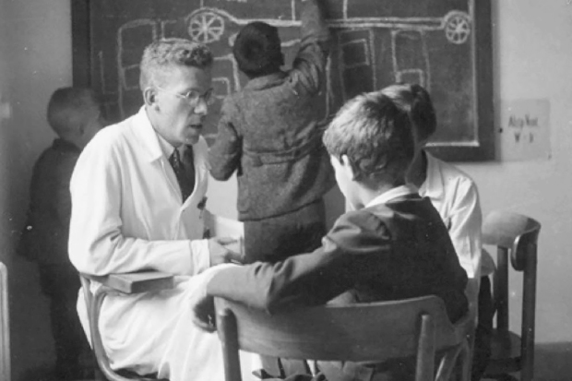
Understanding diversity
‘It seems that for success in science or art, a dash of autism is essential’
Hans Asperger

Slide 16
Too much information
National Autistic Society

Slide 17
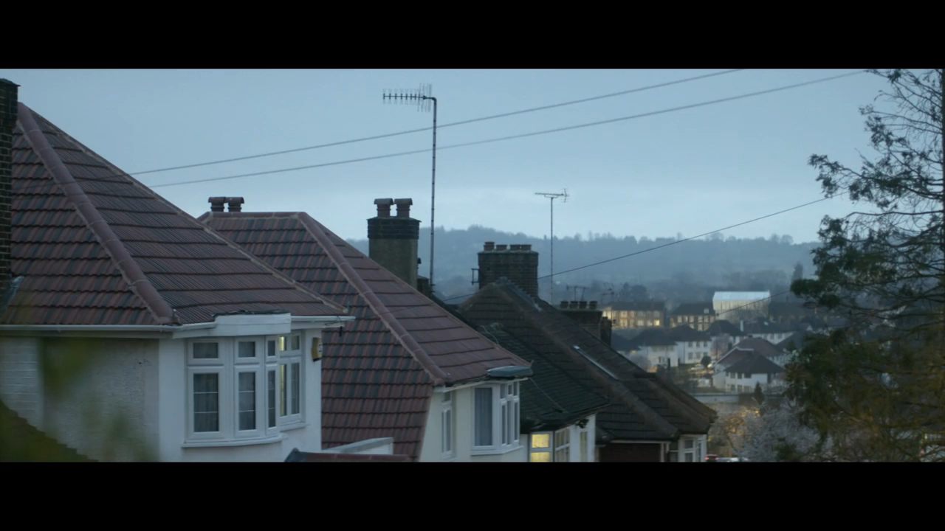

Slide 19

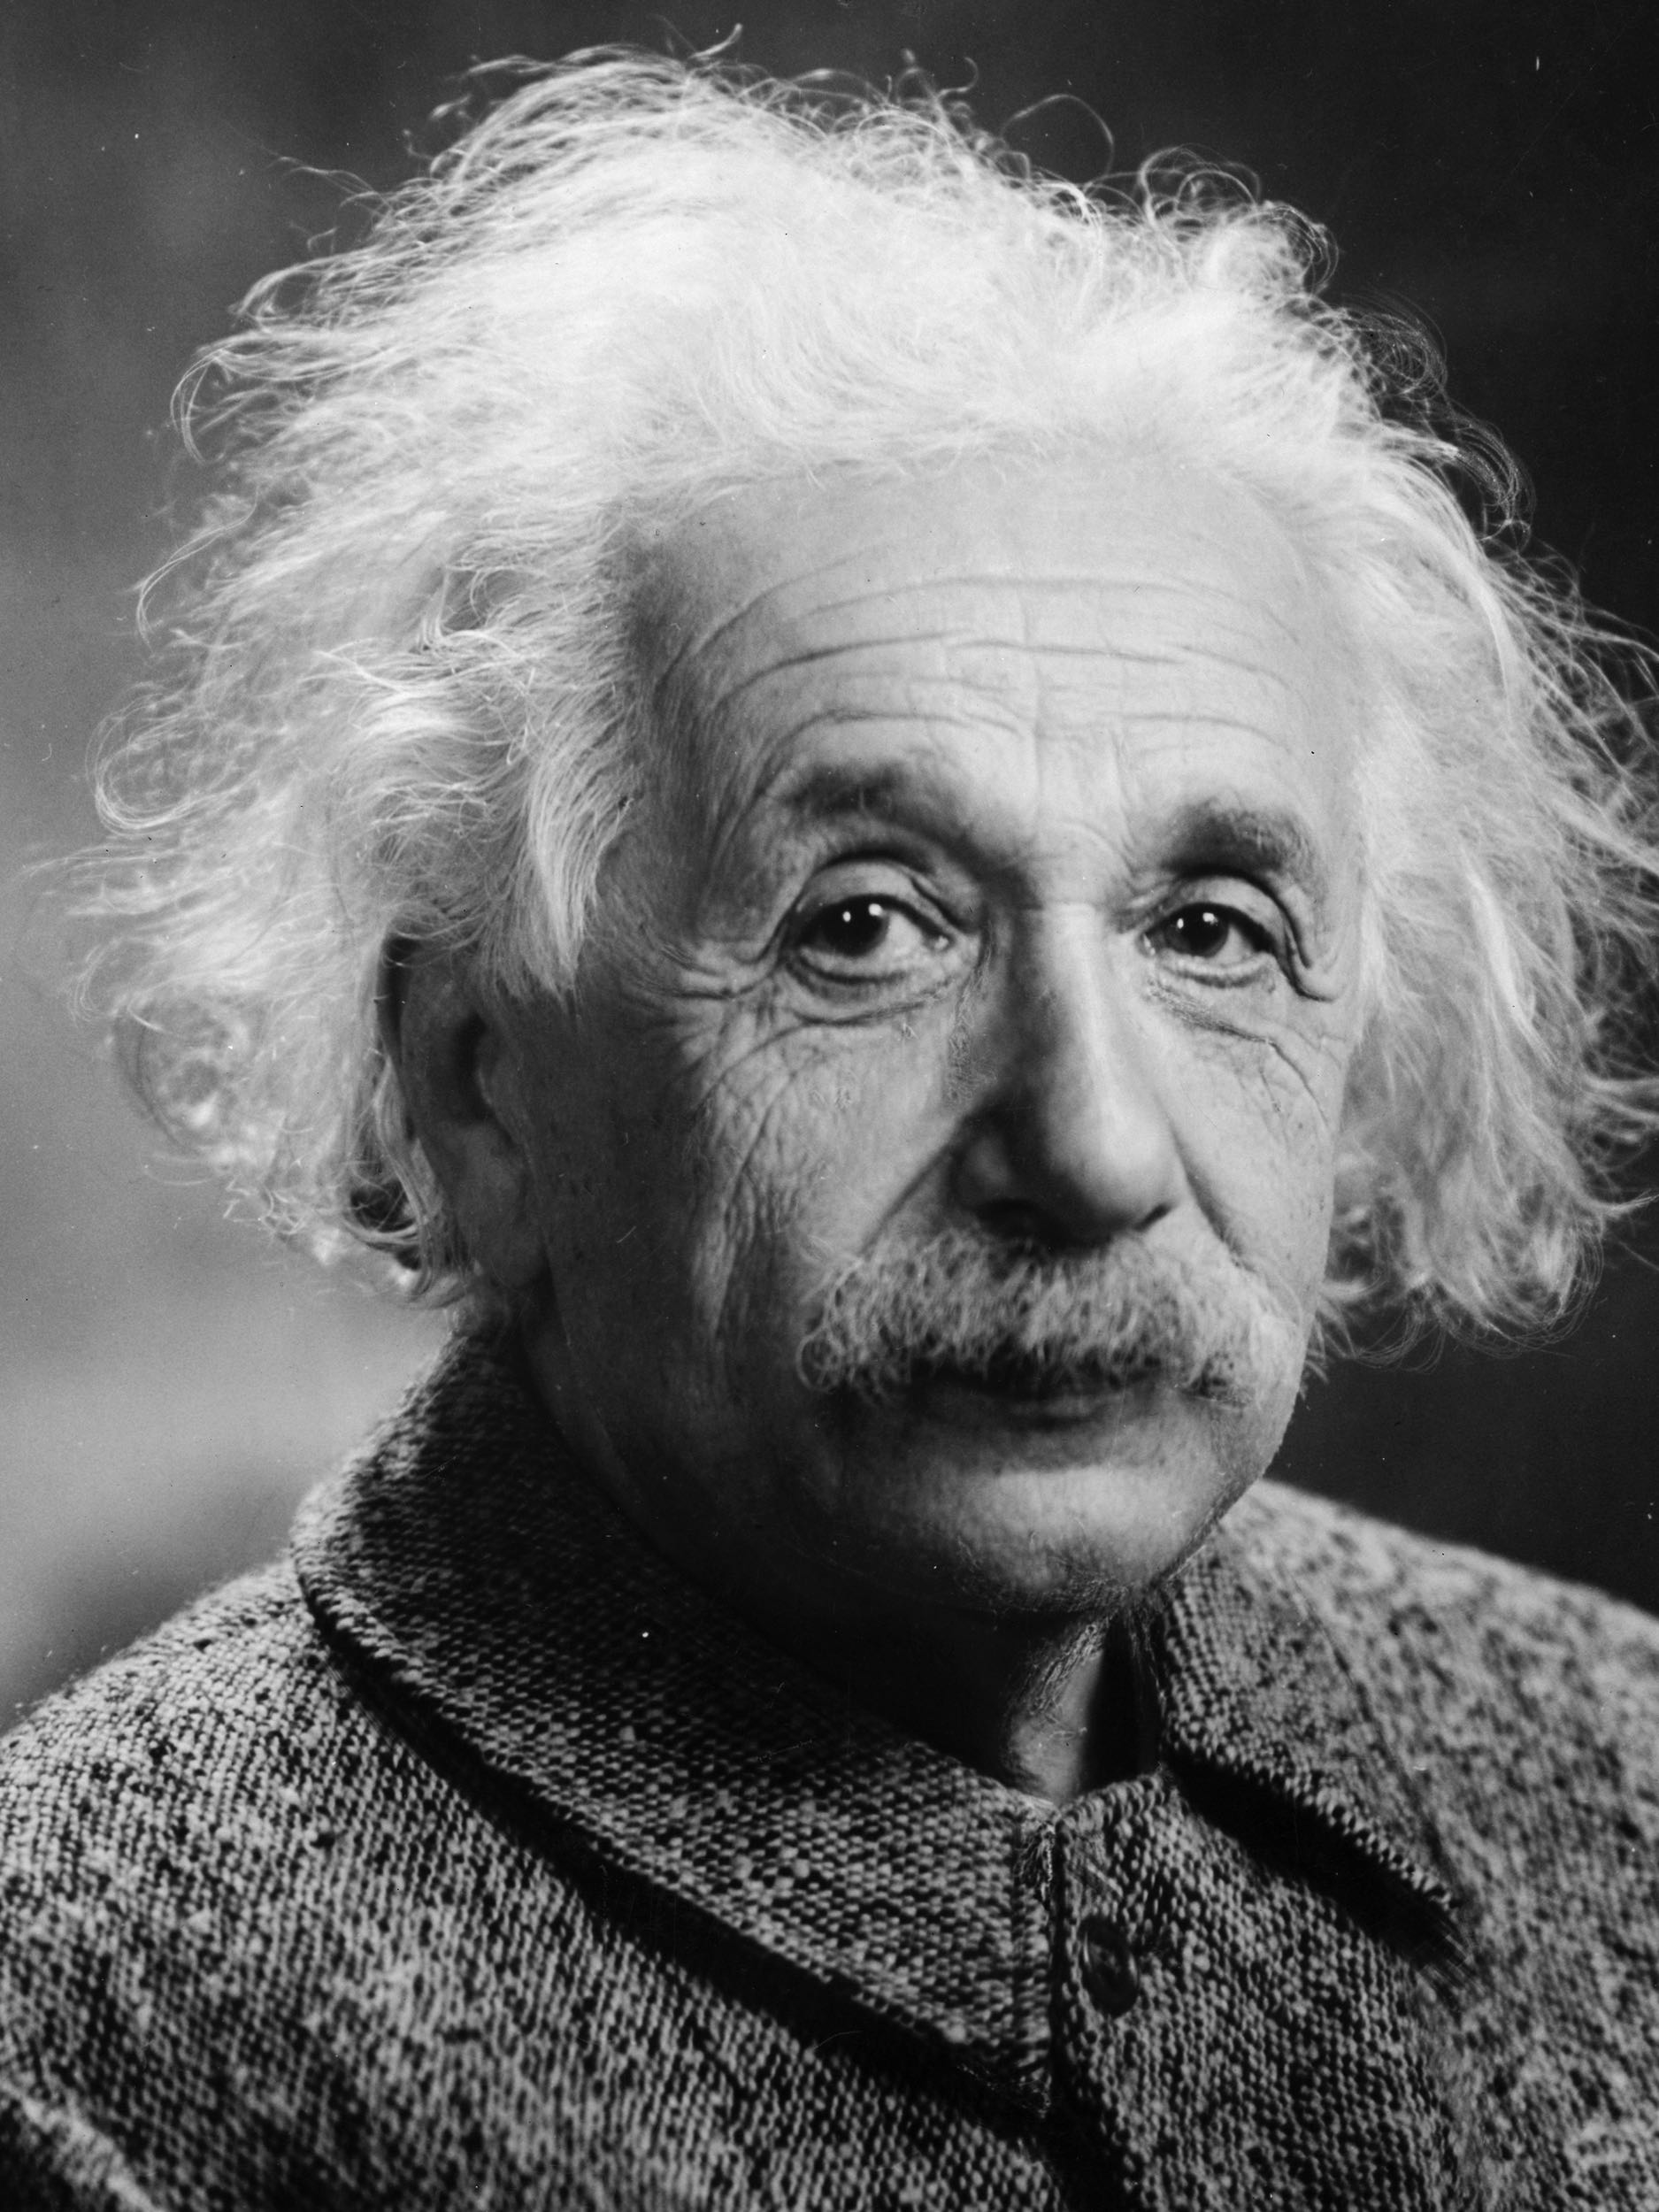

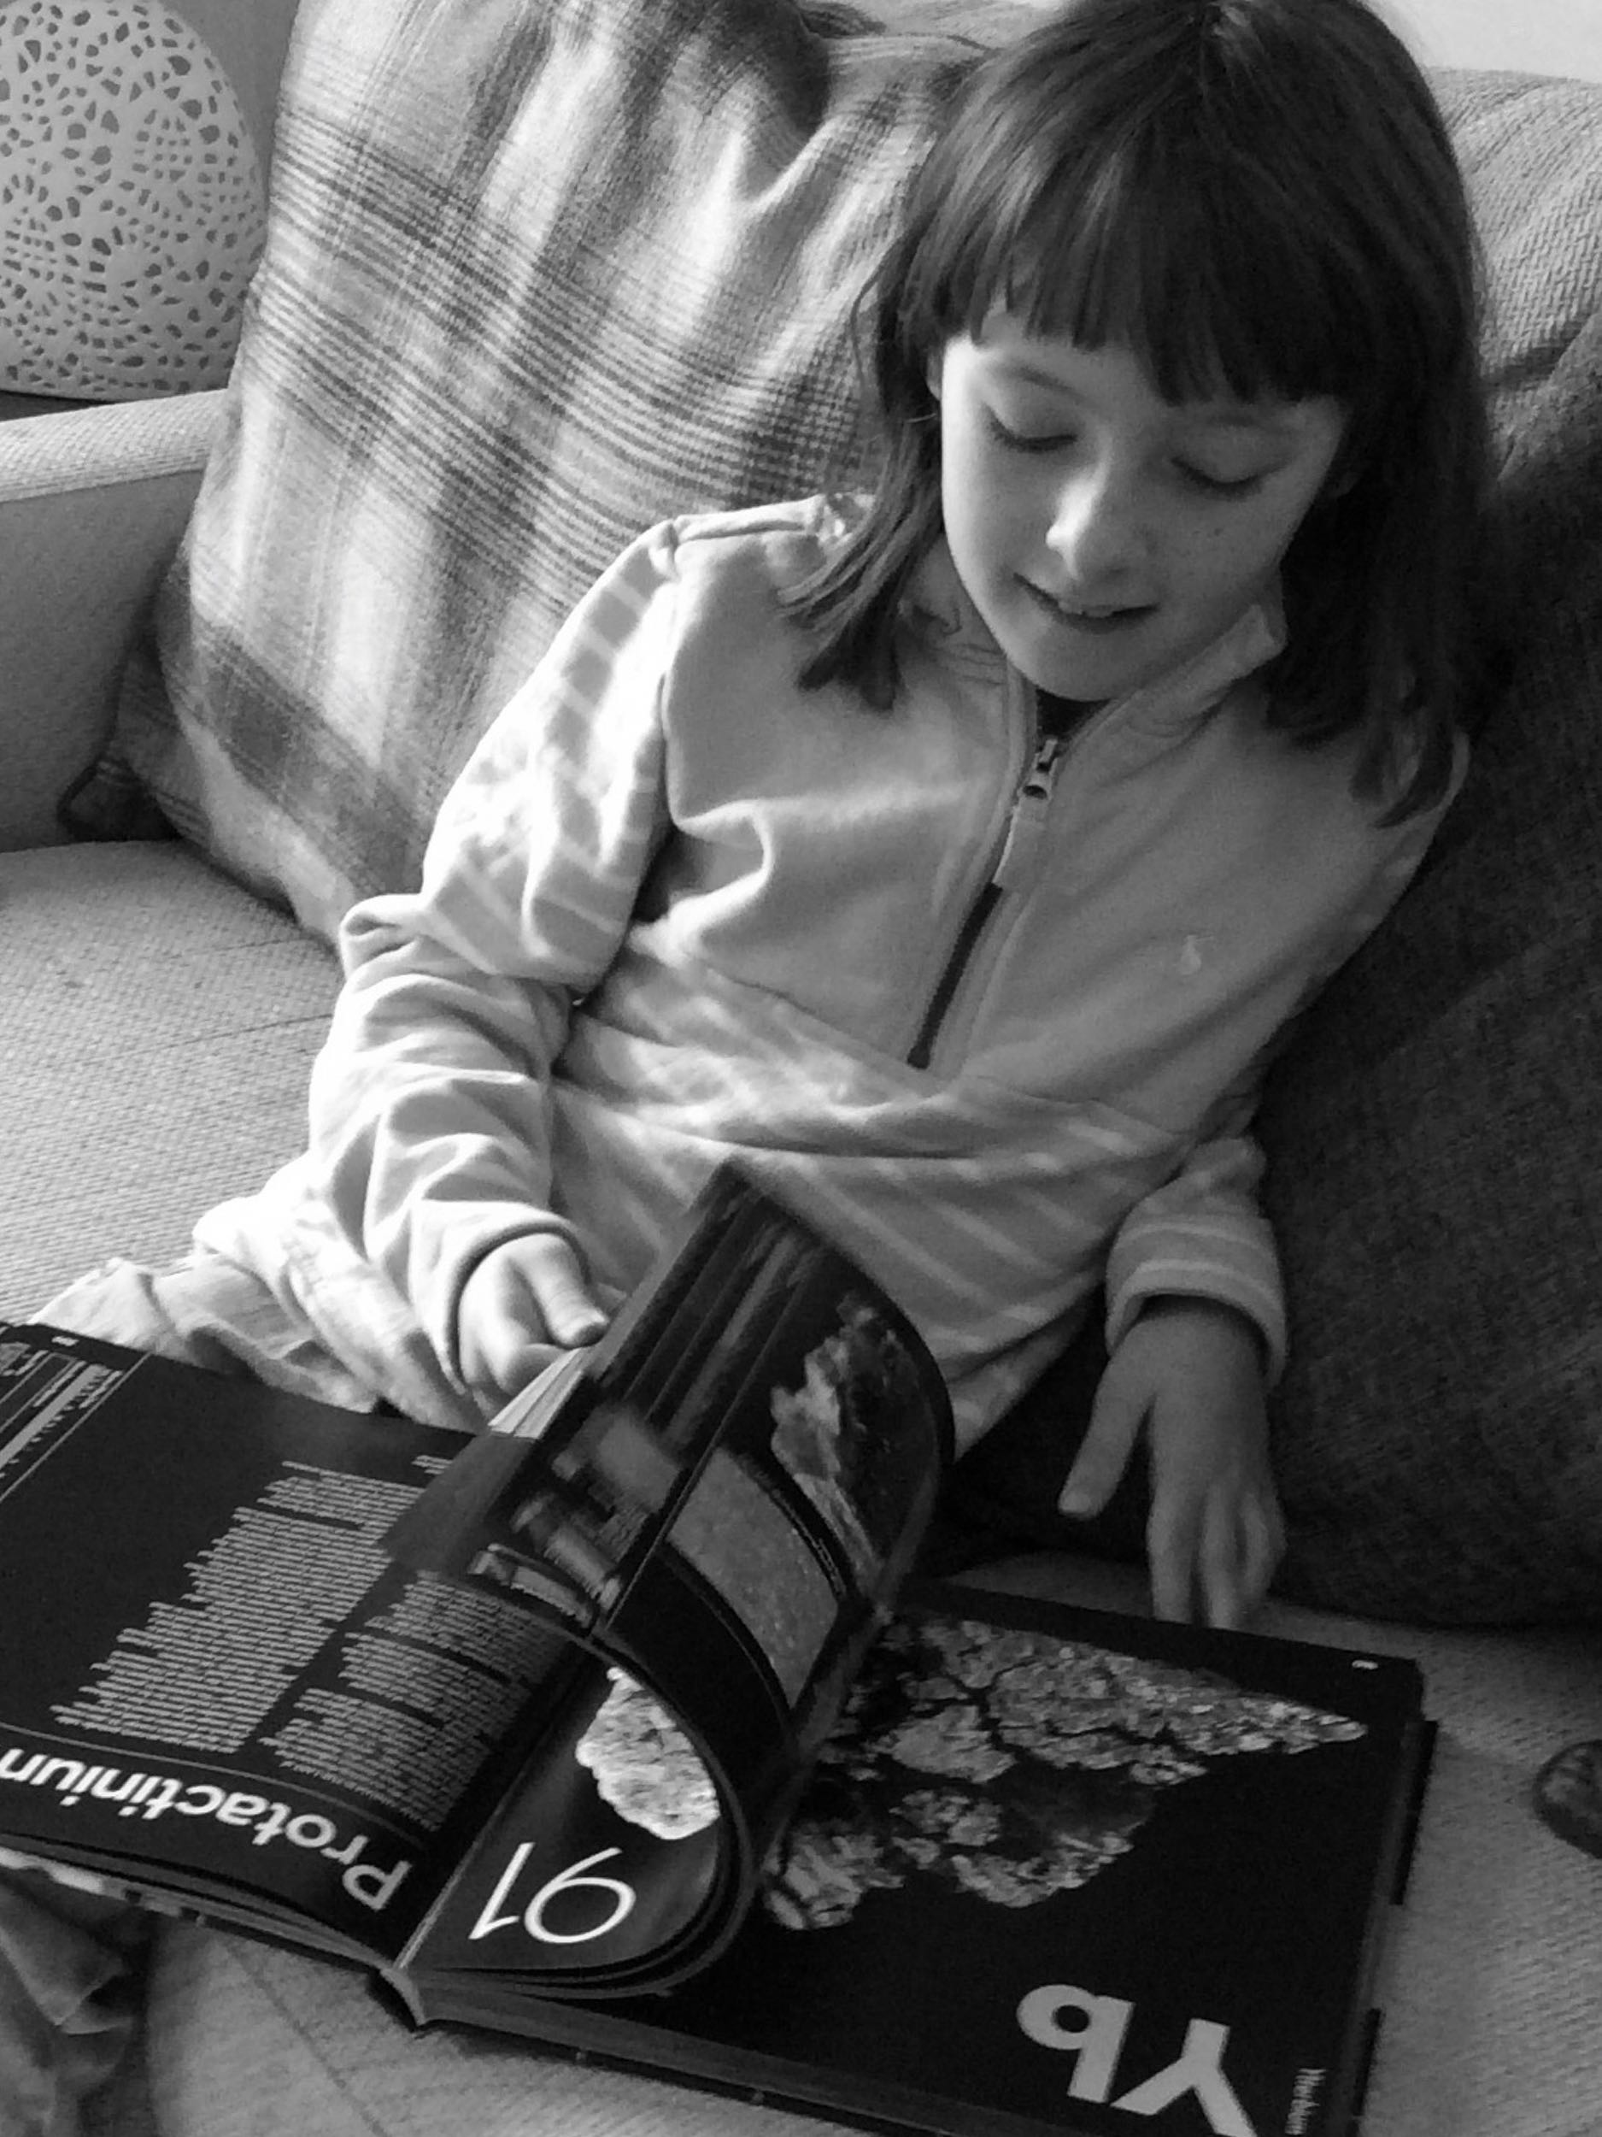

Understanding diversity
How does our daughter fit into this spectrum?
0% Autistic?
100% Autistic?
How does this account for people with such diversity of function?
Perhaps there is a better way to illustrate the condition
A different way of thinking…?

Slide 20

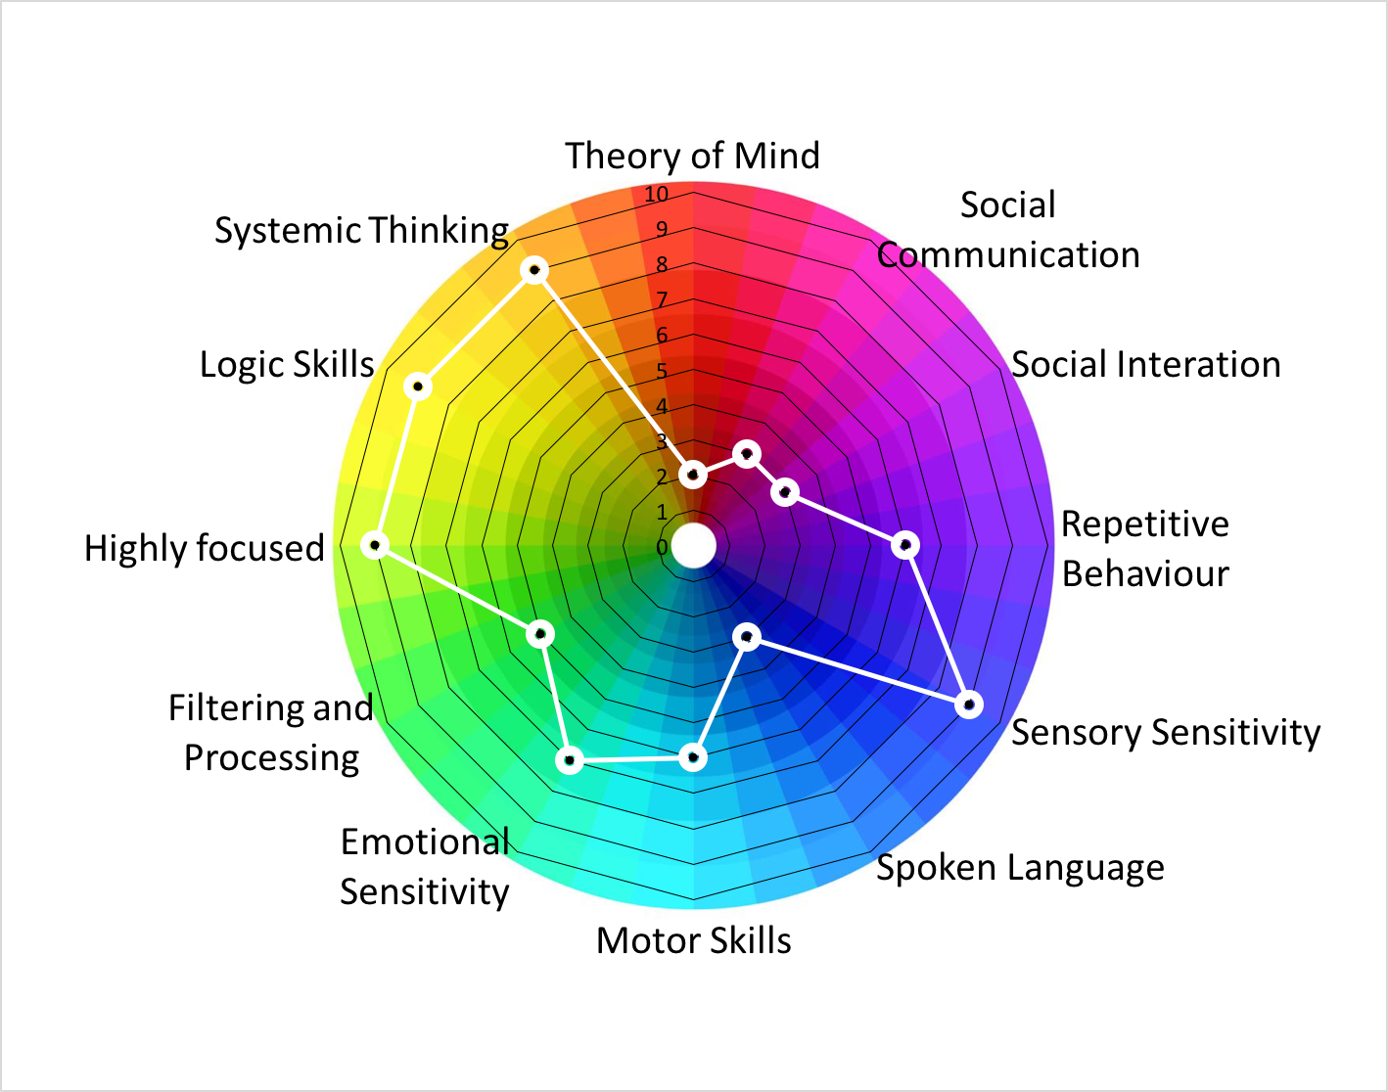
Understanding diversity
Placing someone on a linear spectrum understates the complexity and diversity of functioning

Slide 21

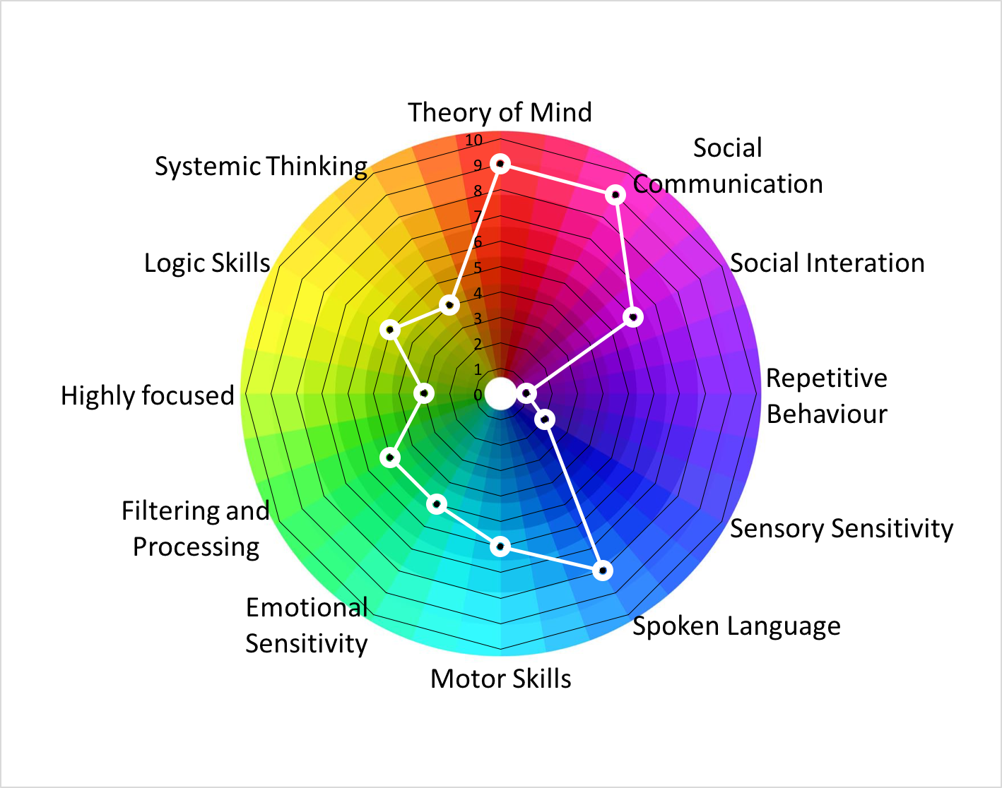
Understanding diversity
One way to think about autism is to consider the idea of Neurodiversity
Some areas may be severely affected (speech), or enhanced (systemizing)
Autistic
Neurotypical

Slide 22

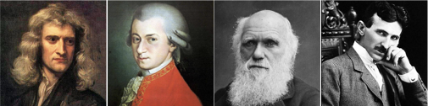
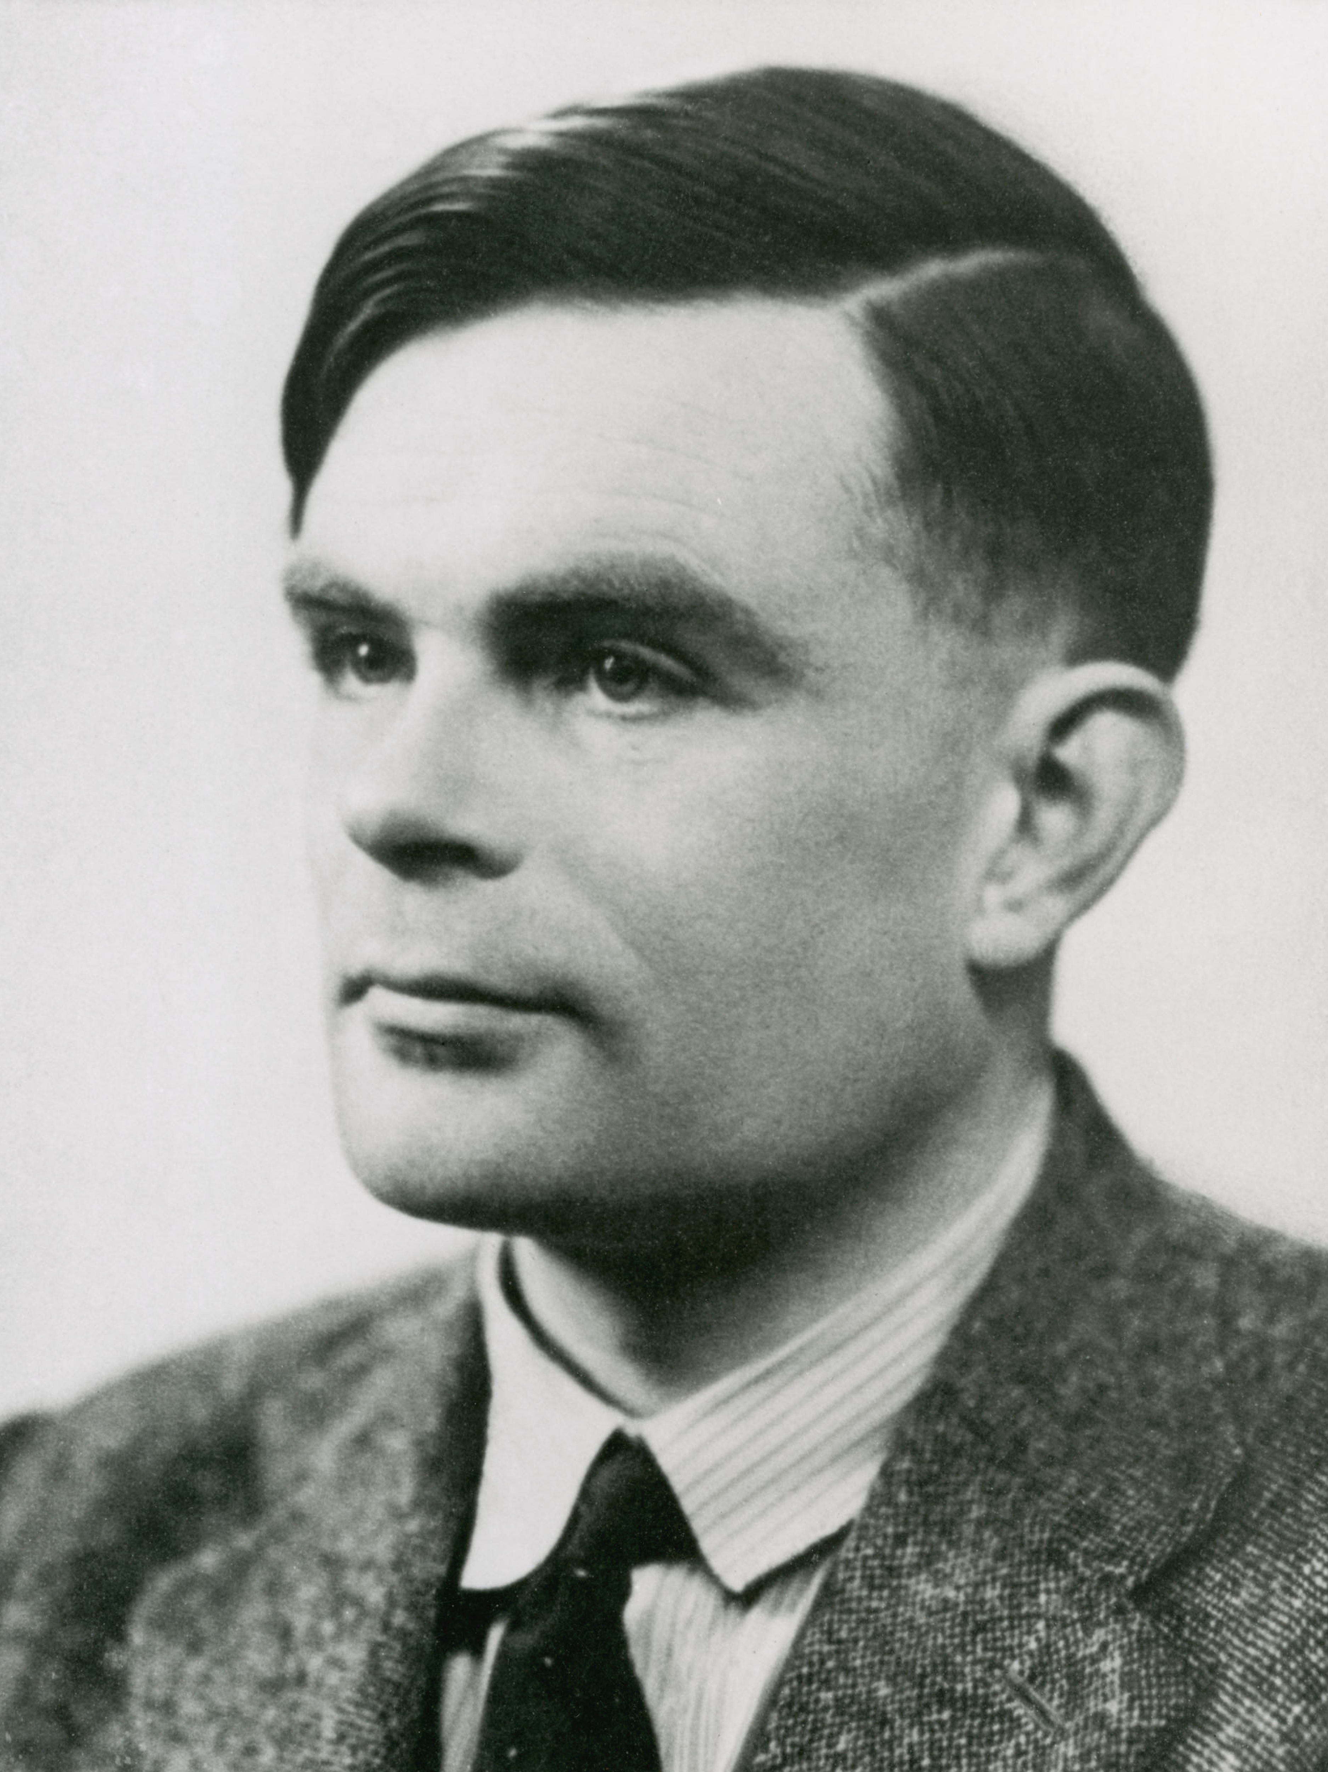
Understanding diversity
Going back to the question: Is there a link between autism and engineering talent?
Lets have a look at Alan Turing using the Gillberg criteria for Asperger syndrome.
Severe impairment in reciprocal social interaction
All-absorbing narrow interest
Impositions of routines and interests
Nonverbal communication problems
Speech and language problems
Motor clumsiness
There are many claims of ASC retrospective diagnoses for talented engineers, scientists and mathematicians (ref: Michael Fitzgerald)
Of course it is not robust to base theories on biographies and retrospective diagnoses.
A more reliable way is to look at living scientists and mathematicians.
Autistic

Slide 23
What is autism
Understanding diversity
The link
What I learnt

Slide 24
The link
Who do you think invented the first stone spear?
“It wasn’t the Yak-Yaks around the campfire.
It was some autistic at the back of the cave chipping away at a rock who figured out how to fasten it to a stick.”
Temple Grandin

Slide 25
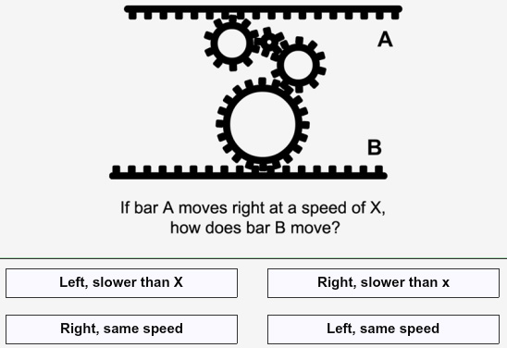
The link
What are the rules controlling this system ?
(c) 2009 Talent in autism: hyper-systemizing, hyper-attention to detail and sensory hypersensitivity
Simon Baron-Cohen*, Emma Ashwin, Chris Ashwin, Teresa Tavassoli and Bhismadev Chakrabarti

Slide 26
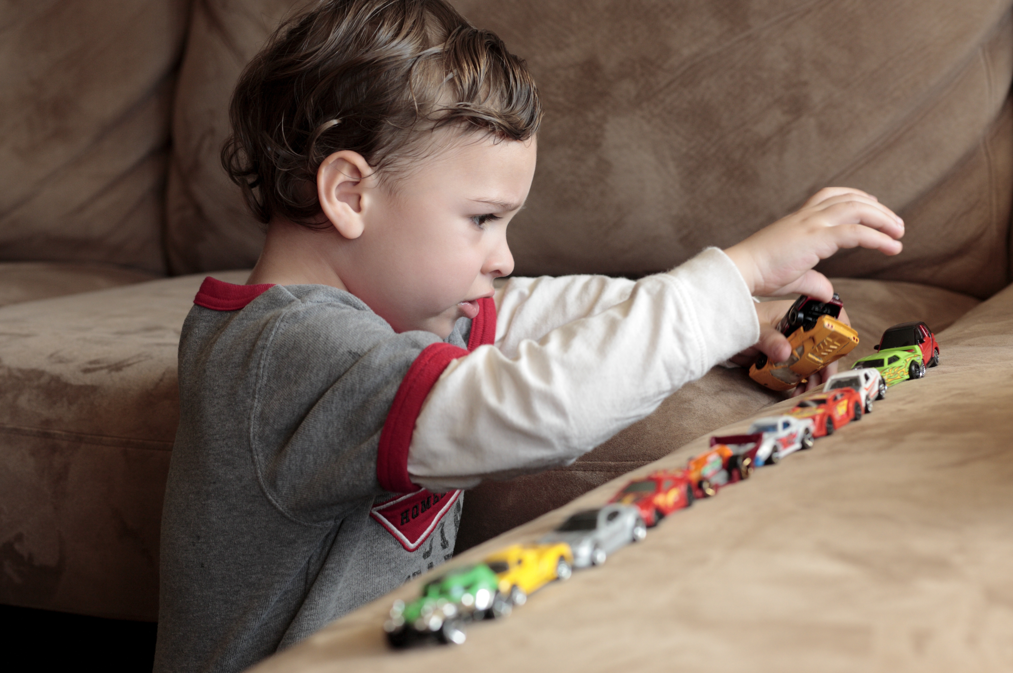




The link
Autistic people and engineers both like to systemise
The system maybe a car engine
Natural like the weather
Abstract computer programme
Library structure
What these systems all have in common - they follow rules
When you have figured out the rules - you can predict what happens next
Now you have can understand the world around you

Slide 27
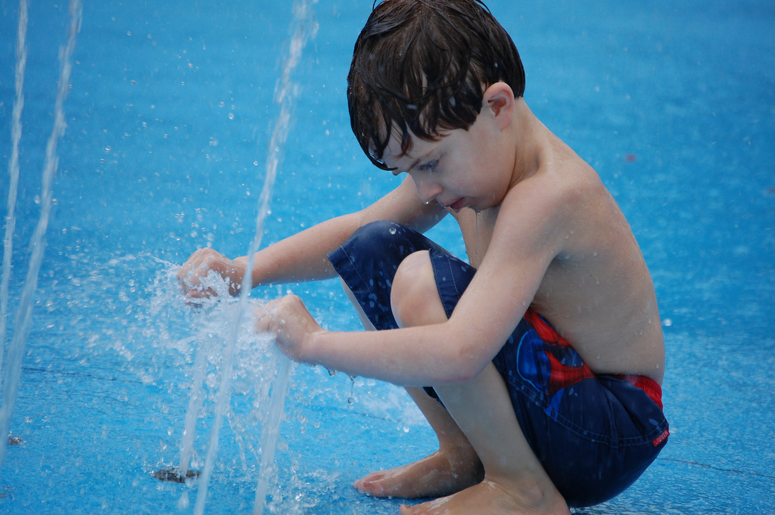
The link
This boy is autistic and fascinated by the flow of water….
He isn’t ‘broken’
He doesn't have a disease
Yes – he needs support
  He is developing differently
  He experiences the world differently
  He is fascinated by how things work
With the right support we can help him understand the rules which govern the world around him

Slide 28
What is autism? Understanding diversity
The link
What I learnt

Slide 29
The Reason I Jump
Naoki Higashida

Slide 30
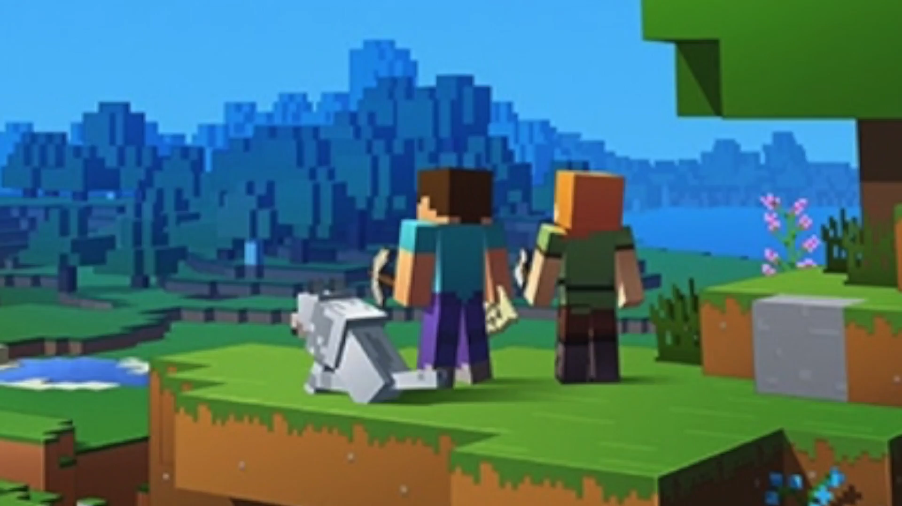

Slide 32


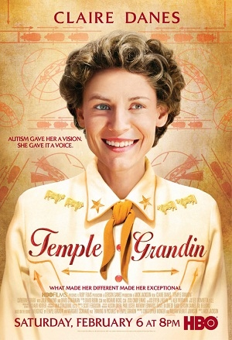
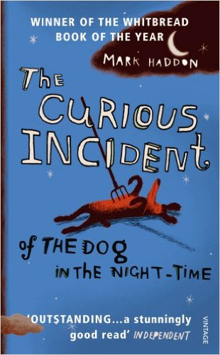

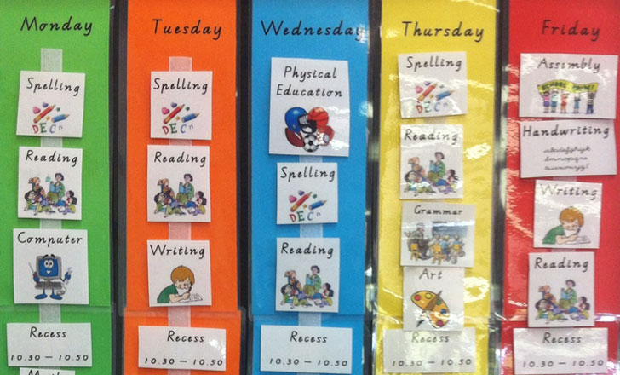
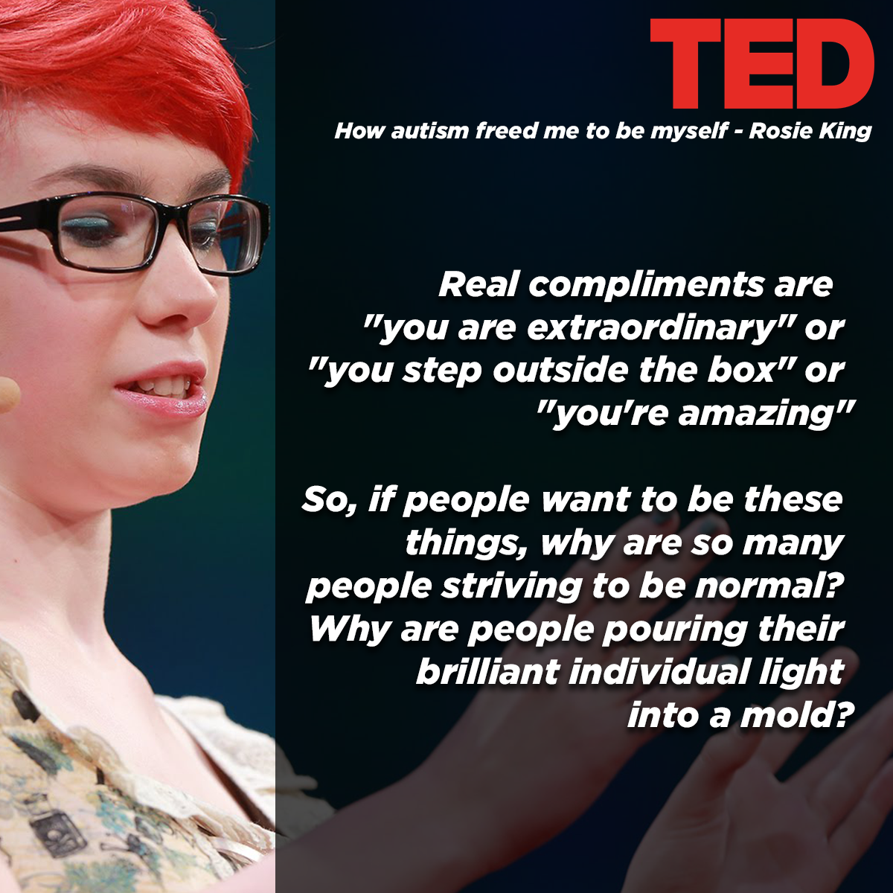
What I learnt
Get Support !
Find your network of people sharing a similar experience. E.g. a charity such as PARC(Chelmsford), SNAP(Warley), NAS
You can learn from those further along in their journey, giving you a perspective that you wont get by yourself.

Slide 33


What I learnt
Autism advocacy:
Autism isn't something a person has, or a "shell" that a person is trapped inside. There's no normal child hidden behind the autism. Autism is a way of being. It is pervasive; it colors every experience, every sensation, perception, thought, emotion, and encounter, every aspect of existence….
Jim Sinclair http://www.autreat.com/dont_mourn.html
There is no piece missing from the jigsaw puzzle
Autistic people have a hard time living in a world not built for them.
The best management for autism is to be found in understanding teachers, accommodating employers, supportive communities, and parents who have faith in their children's potential

Slide 34
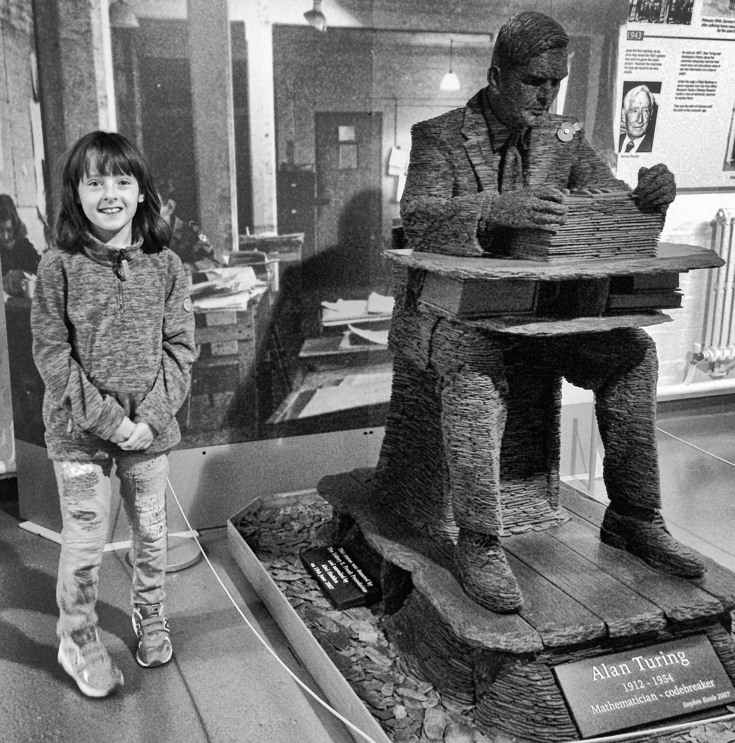
And finally…
So going back to that note from my daughters nursery 5 years ago. That note was wrong!
Emily is NOT sitting alone in her own world laughing to herself. Autism is not an appendage. It is fundamental to her identity.
This world which the nursery talks about, it is not empty either. It is full of people - 2.8 million of them!
Once you get your balance and bearings, you will find a world of people who see your own child’s potential
There is a future – yes it varies immensely!
The child is here now, waiting for their success story to happen.

Slide 35

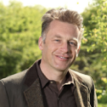
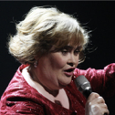
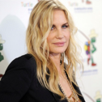
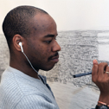
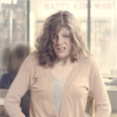

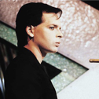
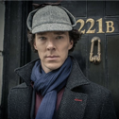
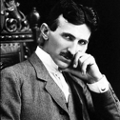

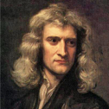
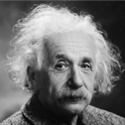
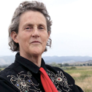
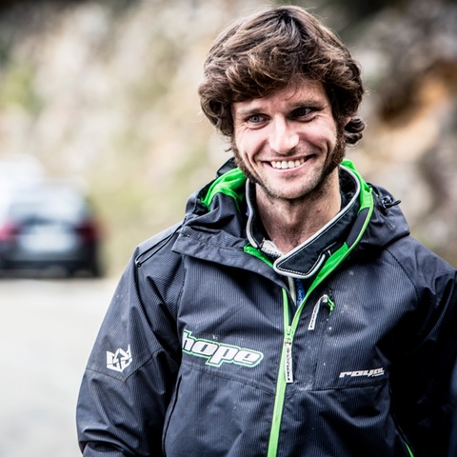
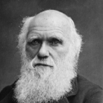
Autism is a way of being
Q&A

